Slide 1
Agglomerative Clustering
What is agglomerative clustering:
To group similar data points into clusters based on their proximity, Agglomerative Clustering is used which is a type of hierarchical clustering. It follows a bottom-up approach, where each data point starts as its own cluster and gradually merges with others based on similarity.
Analogy: Think of family trees:
At the bottom, each person is separate.
Then siblings are grouped, then cousins, then whole families.
Eventually, everyone merges into one big tree. Agglomerative clustering works the same way — starting with each data point as its own cluster and merging them upward.

Slide 2
When to Use
When you want to see hierarchical relationships.
When the number of clusters is not known in advance.
When interpretability (via dendrograms) is important.
Step‑by‑Step Process
Start: each data point is its own cluster.
Find closest pair of clusters (based on chosen linkage).
Merge them into a new cluster.
Repeat until all points are merged into one cluster.
Cut the dendrogram at a chosen level to decide the final number of clusters.

Slide 3
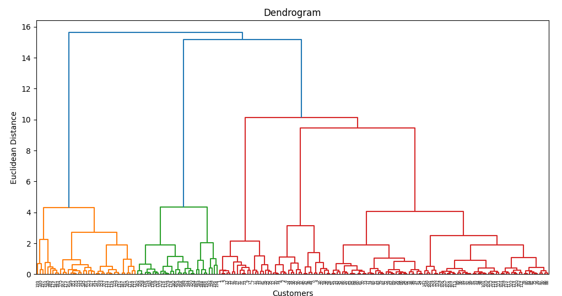
Dendrogram

Slide 4
Why It’s Used in Agglomerative Clustering
Agglomerative clustering is hierarchical: it starts with each point as its own cluster and merges them step by step.
The dendrogram is the visualization of this process.
You use it to decide the optimal number of clusters:
Look for the largest vertical gap (biggest jump in distance).
Cut the dendrogram at that level → that gives you the cluster count.

Slide 5
